Slide 1

The Revolving Refrigerator
Team 5: ISEN 489-503
Anthony Arambula
Aaron Kim
Erin Sylve
Notes:
Aaron

Slide 2

?
Defining the Problem
People restricted to wheelchairs are unable to reach the top shelf of their refrigerators
Specialized refrigerators are too small
Notes:
Aaron

Slide 3
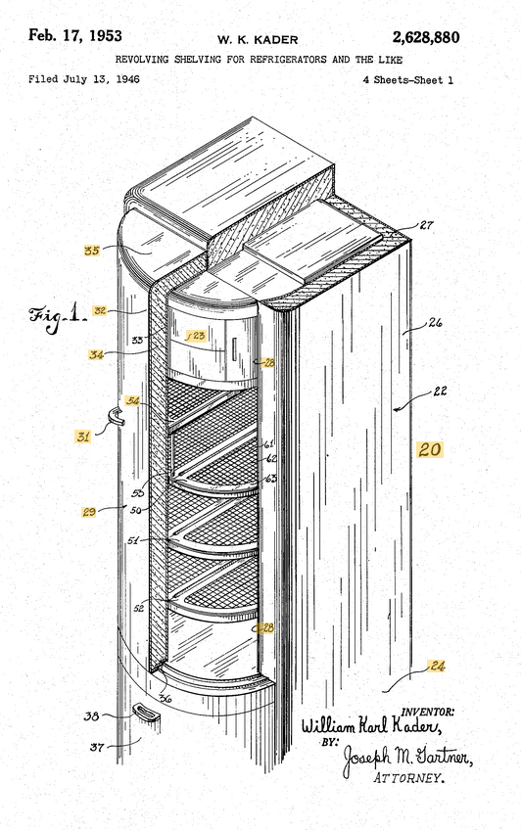
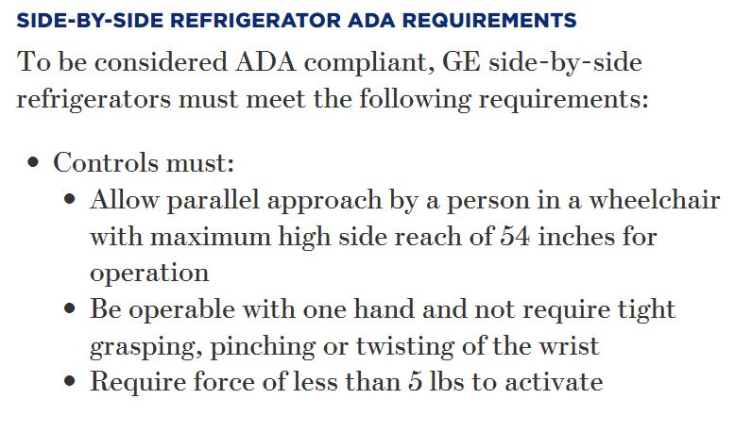
Background Research
Current Patents
ADA Compliant Refrigerator Sizes
Common Refrigerator Materials
Notes:
Erin

Slide 4
Requirements
The Refrigerator System:
Shall move shelves to the user reach
Shall operate at the push of a button
Will be ADA Compliant
Shall fit in the standard kitchen refrigerator size
Notes:
Erin

Slide 5
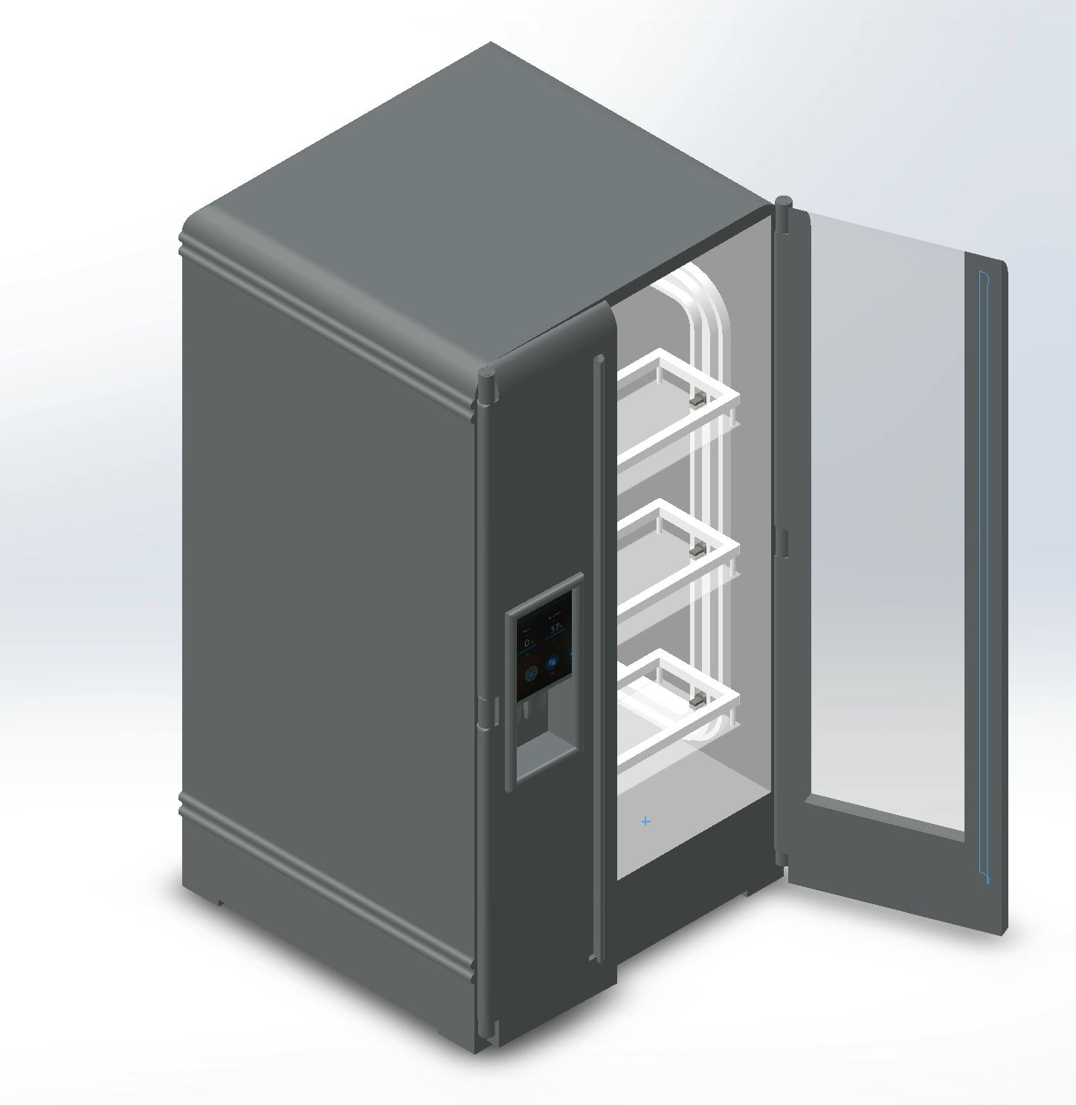
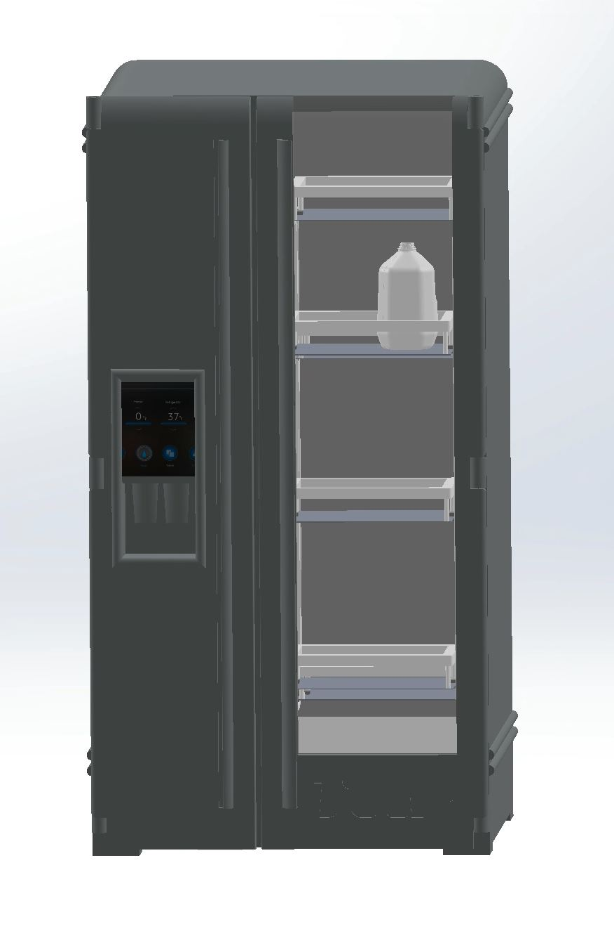
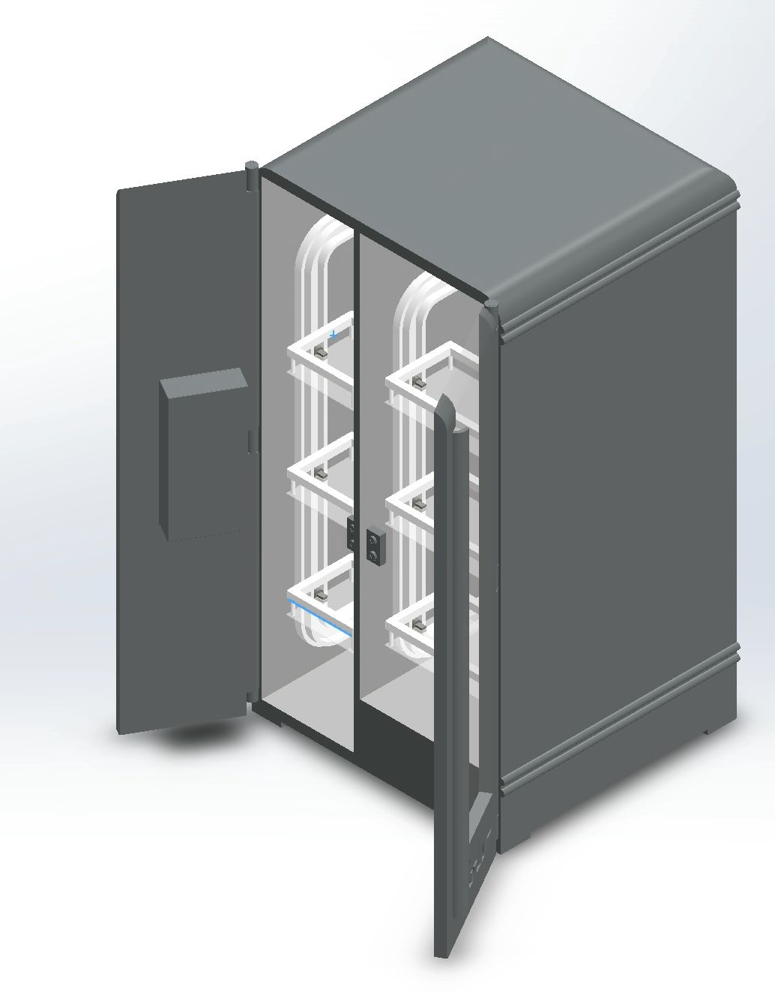
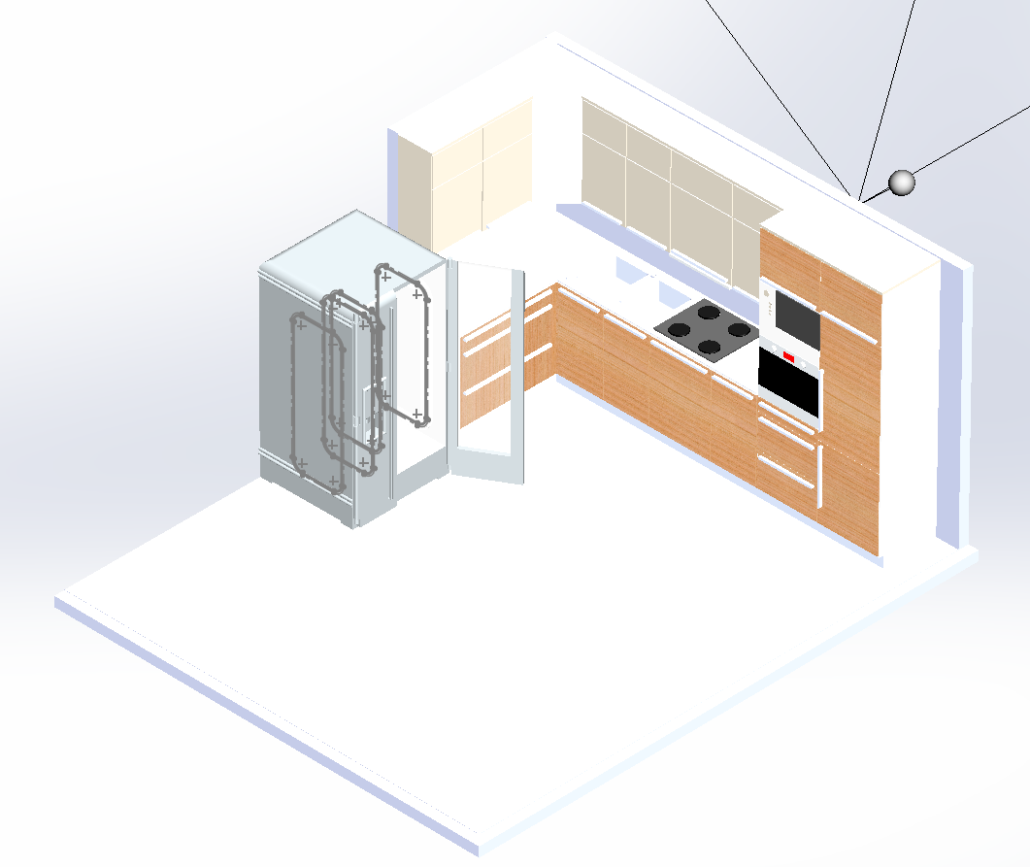
Introducing the Solution
Notes:
Aaron

Slide 6
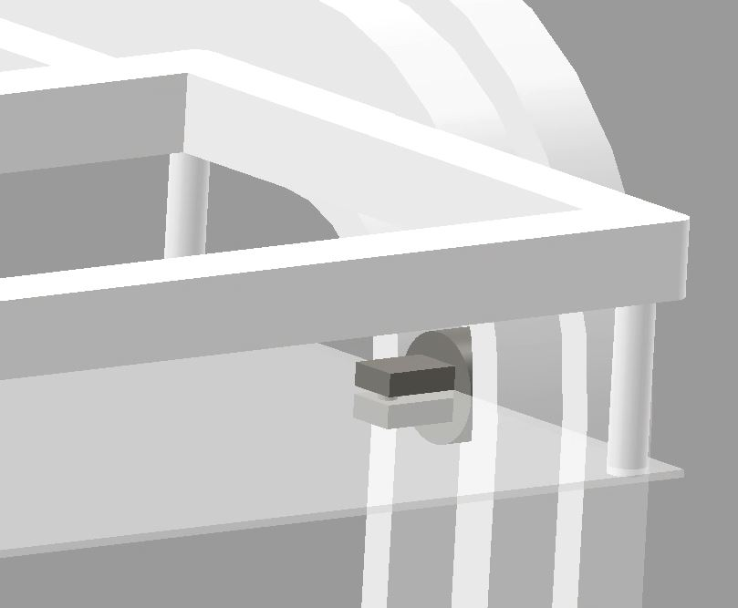
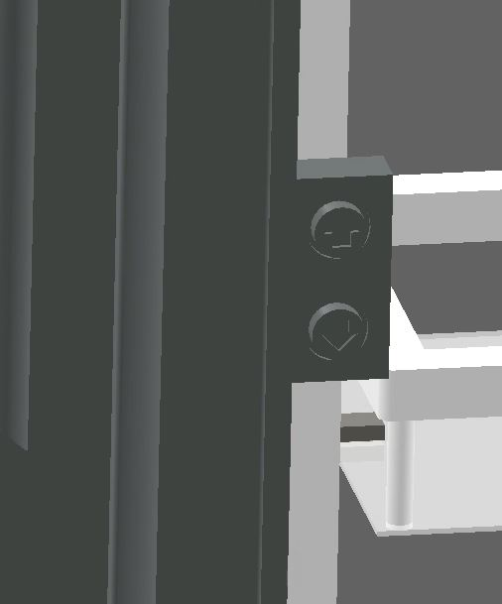
Fridge Design
Featured Systems:
Pins made for Adjustable Shelf Height
Two-Button Shelf Rotation Control
Modern Design!
Notes:
Anthony

Slide 7
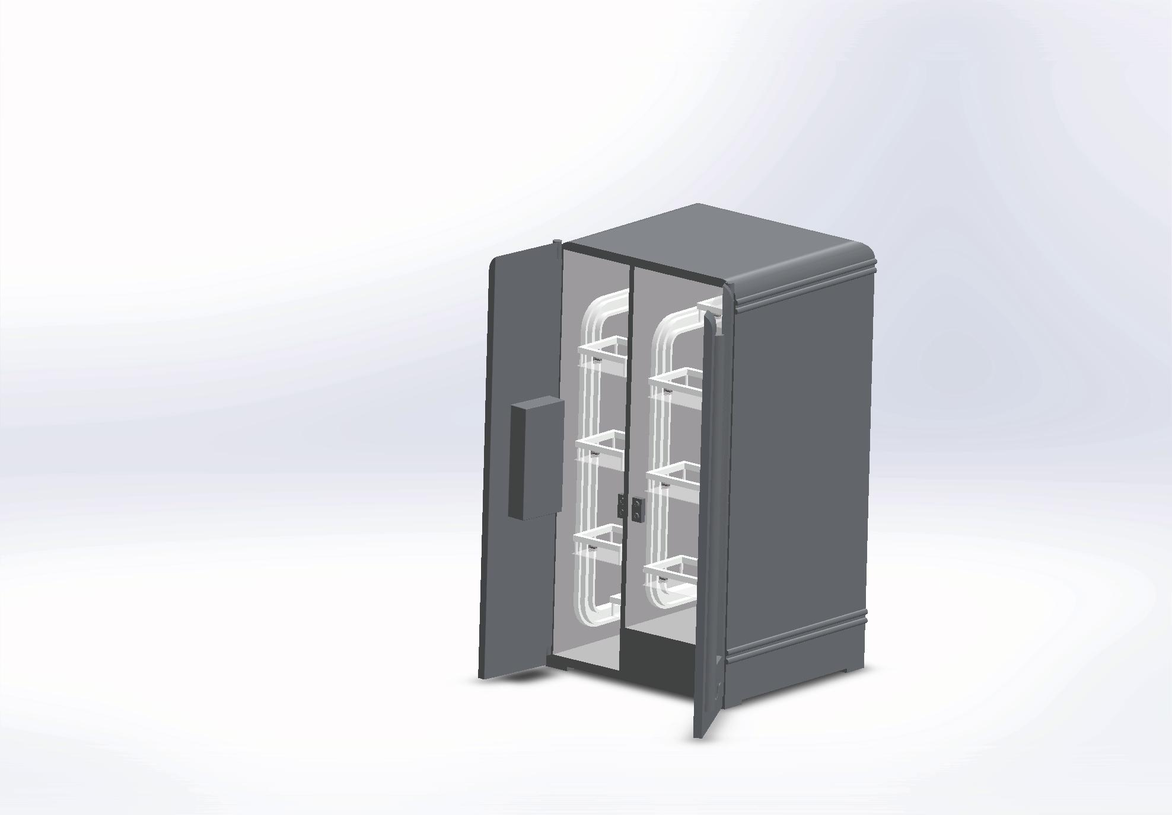
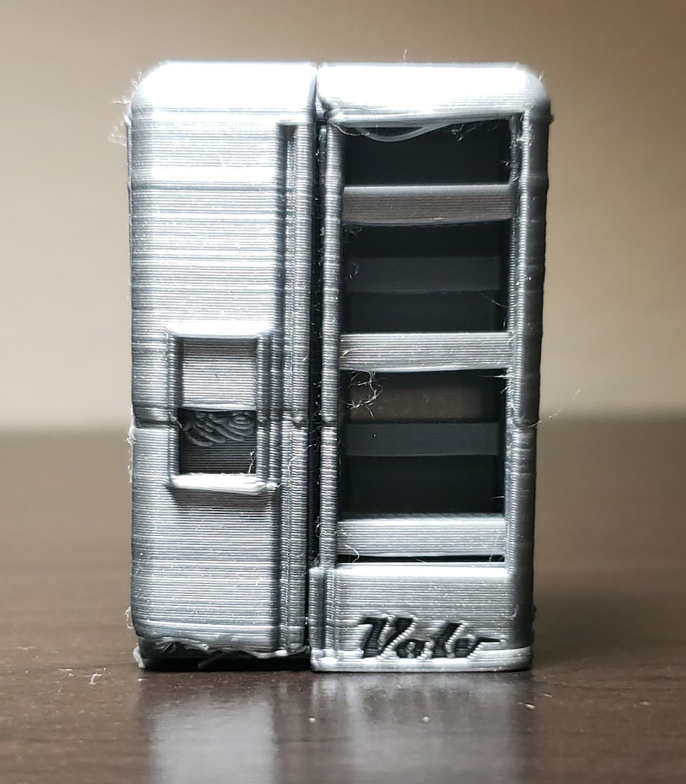
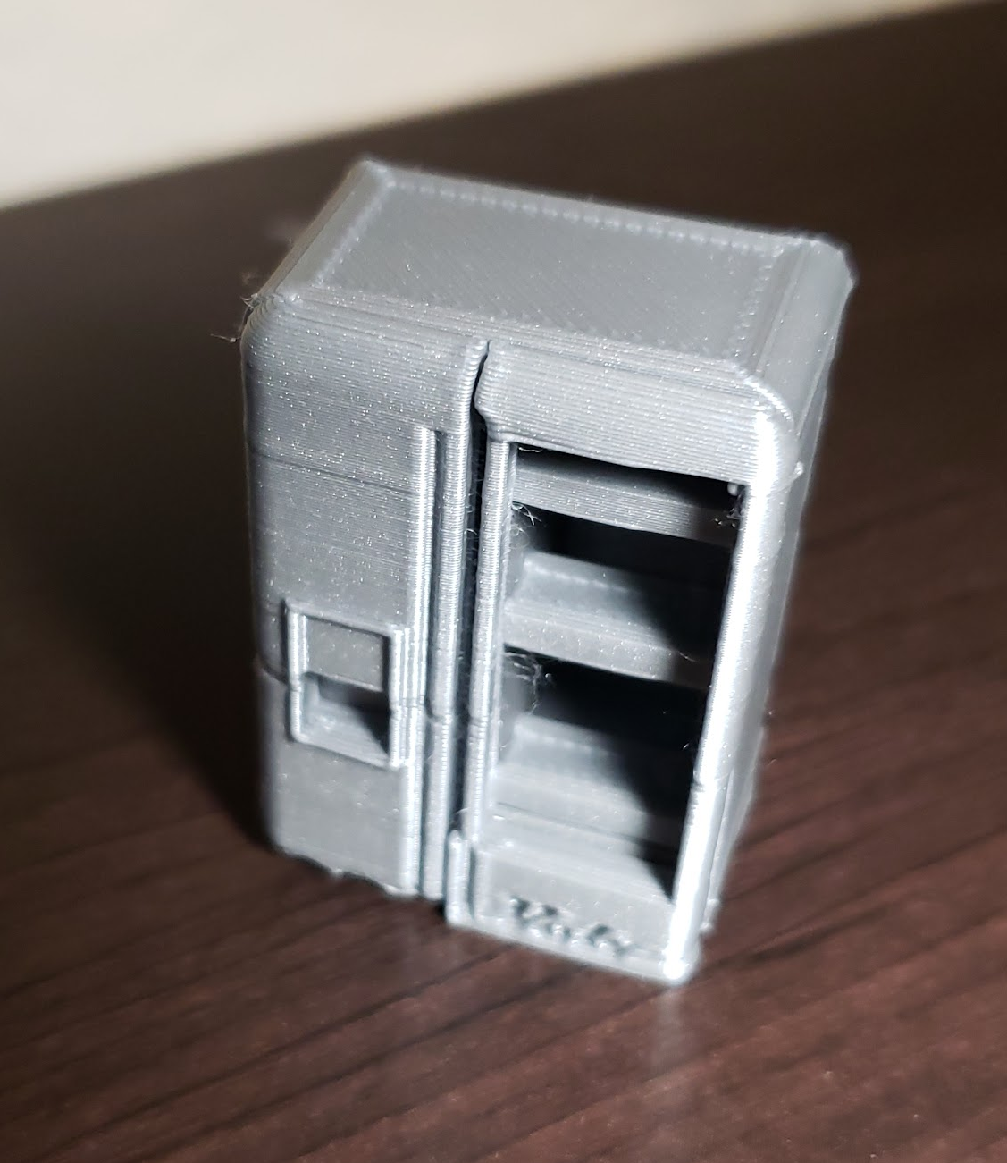
Prototyping
3D Printed Model (1/40 Scale)
Notes:
Anthony

Slide 8
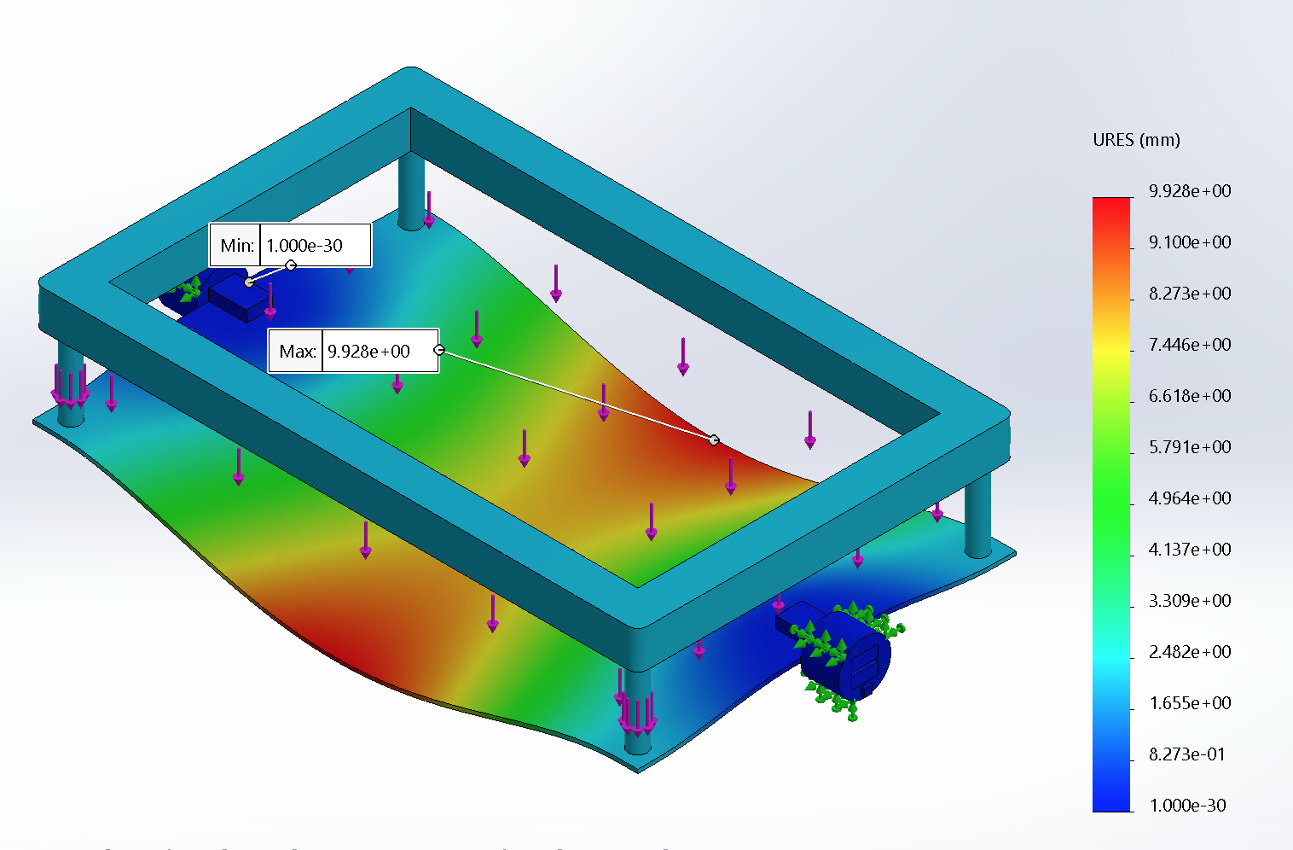
Testing
Fridge Shelf Load Testing
User Testing
User 1: “Even if I am tall, I believe it is useful for people to use this revolving refrigerator to reach the deep inside part of the refrigerator. I always had trouble reaching the end part of the shelf, but this refrigerator is so helpful!”
User 2: “I am so grateful that this refrigerator exists as it lets me use a refrigerator without any help from my family members.”
User 3: “I really like this product! It is really creative! I can now drink chocolate [milk] hidden from my brother!”
Notes:
Anthony

Slide 9
Manufacturing
Process Plan:
Stamp and Bend Sheet metal to form outside of refrigerator.
Form inside of refrigerator, rail, shelf clips, and shelves with vacuum injection molding.
Assemble machined parts with electronics, weld sheet metal, and inject insulating foam.
Notes:
Erin

Slide 10
Further Development
Individualized Shelf Temperatures
Design Smart Hub GUI
Create different Refrigerator Layouts
Notes:
Erin

Slide 11
Thank you.
If you have questions, comments or concerns, feel free to email sylveerin@gmail.com.
Notes:
Aaron

